Slide 1


Session 2020-21
ART INTEGRATED PROJECT
SUBJECT- COMPUTER SCIENCE
CLASS: XII

Slide 2


EK BHARAT SHRESTHA BHARAT
MANIPUR
NAGALAND

Slide 3
FACTS ABOUT MANIPUR
Formation – 21 January 1972
Capital – Imphal
Districts – 16
Total Area – 22,327 sq km
Total Population – 2,855,794
Density – 130/sq km
Languages – Meitei(Manipur)
Literacy Rate – 79.85%

Slide 4
FACTS ABOUT NAGALAND
Formation – 1 December 1963
Capital – Kohima
Districts – 12
Total Area – 16,579 sq km
Total Population – 1,980,602
Density – 119/sq km
Languages – English
Literacy Rate – 80.11%

Slide 5


STATE EMBLEM
MANIPUR NAGALAND

Slide 6


STATE ANIMAL
SANGAI
(MANIPUR) GAYAL
(NAGALAND)

Slide 7
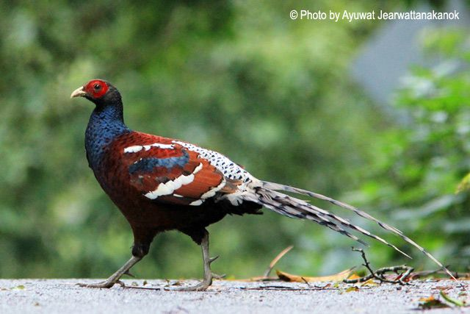

STATE BIRD
MRS. HUMES PHEASENT BLYTH’S TRAGOPAN
(MANIPUR) (NAGALAND)

Slide 8
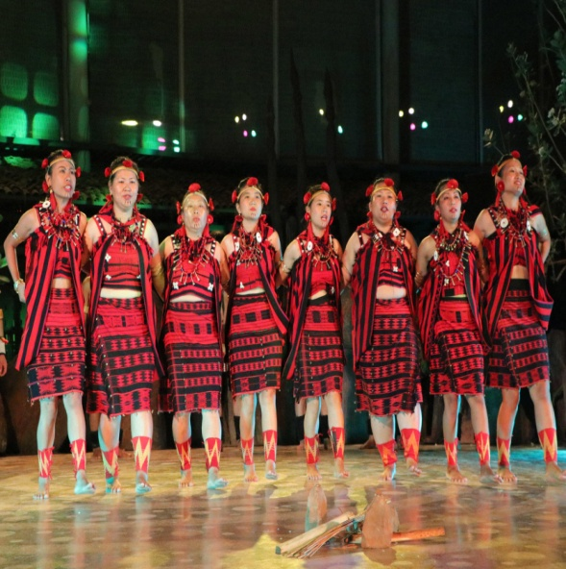
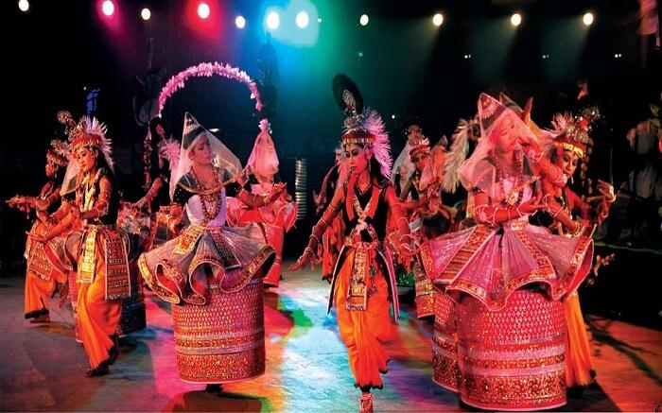

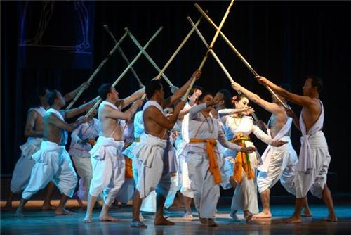
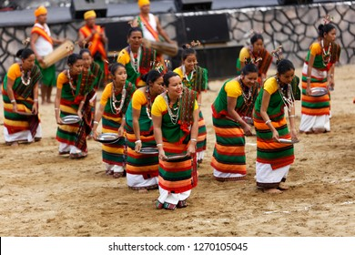
CULTURE OF MANIPUR AND NAGALAND

Slide 9

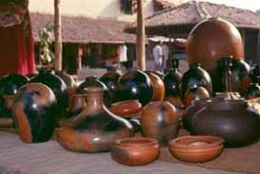
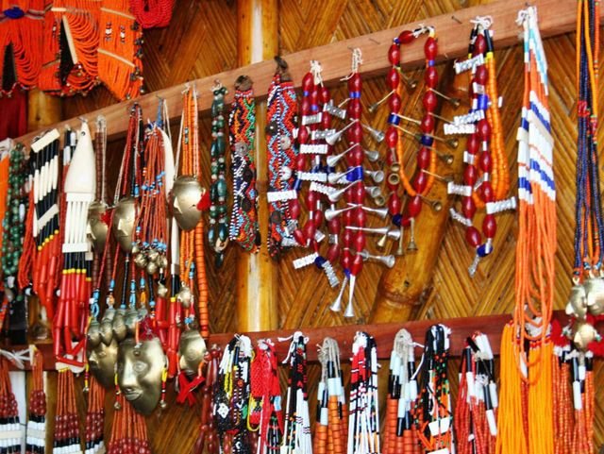

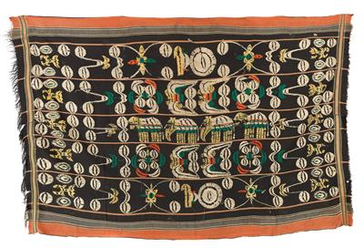
ART OF MANIPUR AND NAGALAND

Slide 10

INTRODUCTION TO IT
Information technology (IT) is the use of computers to store, retrieve, transmit, and manipulate data or information. IT is typically used within the context of business operations as opposed to personal or entertainment technologies. IT is considered to be a subset of information and communications technology (ICT). An information technology system (IT system) is generally an information system, a communications system, or, more specifically speaking, a computer system – including all hardware, software, and peripheral equipment – operated by a limited group of users.

Slide 11
STATE WIDE AREA NETWORK

Slide 12
MANIPUR
Under the national e-Governance Plan (NeGP) by the Department of Information Technology, Government of India, the first phase of the installation work of State-wide Area Network (SWAN) in Manipur has been underway.
National Informatics Centre (NIC) has taken the responsibility of installing SWAN under NeGP in Manipur and consequently computerisation work of the important Government Departments in Manipur has been started. All these programmes would bring transparency in the governance and enable the common people to have easy accessibility to information. After the successful implementation of NeGP, people would be able to download information from the official website of the Departments concerned not only from Community Information Centres (CIC) and cyber cafes but also through the help of mobile phones.

Slide 13
NAGALAND
The Nagaland State Wide Area Network is operational and it is providing Internet connectivity (data, voice and video communications) throughout the State. SWAN Third Party Audit (TPA) (M/s Price Water House Cooper) has successfully conducted technical audit activities in various Points of Presence as per Service Level Agreement. In addition to the exising Project Requirements, the Naga SWAN has also been extended to all the District Taxes Offices to provide for secure connectivity for the GST Network (GSTN)
The Department has also initiated steps to provide Horizontal connectivity to various Government Offices at the District level so that the built up infrastructures are utilized optimally.

Slide 14
STATE DATA CENTRE

Slide 15
MANIPUR
NIC, under the Department of Information Technology of the Government of India, is a premier Science and Technology Organization, at the forefront of the active promotion and implementation of Information and Communication Technology(ICT) solutions in the government. NIC has spearheaded the e-Governance drive in the country for the last three decades building a strong foundation for better and more transparent governance and assisting the government’s endeavour to reach the unreached.
With the increased expectations from citizens for online services and the number of e-Governance Projects being launched by the Government, the Data Centre requirements are growing exponentially. There is a need to set up strategic infrastructure that facilitates high availability , quick scalability, efficient management & optimized utilization of resources.
To fulfil this requirement , NIC has set up state-of-the-art National Data Centres at NIC Hqrs, Delhi, Pune and Hyderabad and 30 small data centres at various state capitals to provide services to the Government at all levels. These Data Centres combine round-the-clock operations and management of systems with onsite skilled personnel.

Slide 16
NAGALAND
Nagaland State Data Centre (NSDC) acts as a mediator and convergence point between open unsecured public domain and sensitive government environment. It has been set up as a Tier-II Data Centre. It enables various State departments of Nagaland to host thier service/applications on a common infrastructure leading to ease of integration and efficient management, ensuring that computing resources and the support infrastructure is adequately and optimally used. The NSDCE is equipped to host /co-locate systems(e.g Web servers, Application Servers, Database servers, SAN etc) to host applications at the SDC, to use the centralized computing power. The centralized computers/servers are used to host multiple applications.

Slide 17
COMMON SERVICE CENTRE

Slide 18
MANIPUR
Common Service Centers (CSC) have been opened in Manipur by the government of India at various locations across the state. You can find out the nearest Common Service Center District in Manipur State by choosing your respective District from the below-mentioned drop-down under the State of Manipur. Individuals can get an array of services from CSC be it for Aadhaar Enrollment, Aadhar Card Registration, Insurance services, Passport, E-Aadhar letter download and print, Birth and Death Certificates and so on.

Slide 19
NAGALAND
The CSCs are operated and managed by the Village Level Entrepreneur (VLE) and various trainings to VLEs were given for providing various Central Government Schemes, lile AYUSHMAN BHARAT, 7th Economic Census, Insurance, Pradhan Mantri Jan Dhan Yojna etc. through the CSCs. The CSCs are also providing Online Application for State Scholarships, Online Admission for the Academic Year 2021 for the Department of School Education, Government of Nagaland.

Slide 20
THANK YOU

